Slide 1



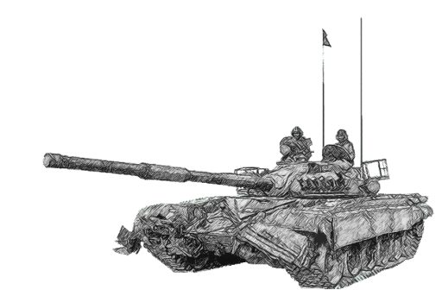
SCHOOL OF TECH TRG
ELECTRONICS WING
Notes:
.

Slide 2
SCHOOL OF TECH TRG
DIGITAL COMN
Notes:
.

Slide 3
DIGITAL COMN
ANALOG SIGS
CONTINUOUS
DIFF VALUES IN A LIMITED RANGE AT A PARTICULAR INSTANT OF TIME
EG - VOICE

Slide 4
DIGITAL COMN
DIGITAL SIGS :- THE TYPE OF SIGS WHICH HAVE ONLY TWO DISCRETE VALUES OR LEVELS LIKE HIGH AND LOW OR ZERO AND ONE FOR THE DATA BEING TRANSMITTED DURING ANY PARTICULAR INSTANCE OF TIME .
eg - CALCULATOR, MICRO PROCESSOR.

Slide 5
ADV OF DIGITAL OVER ANALOG
EASIER CCTS AS ONLY TWO LEVELS.
ALL TYPES OF MUX POSSIBLE.
HAVE CAPABILITY OF MEMORY HENCE USED IN CMPTRS.
LESS CHANCES OF ERRORS OVER LONG DISTANCE i-e ATTENUATION DO NOT HAVE MUCH EFFECT.

Slide 6
ADV OF DIGITAL OVER ANALOG
LATEST ELEC SYS MOSTLY DIGITAL.
RUGGED i.e MORE IMMUNE TO CHANNEL NOISE.
CAN BE EASILY CODED.
IMMUNITY TO NOISE AS ONLY PRESENCE
AND ABSENCE OF SIGS ARE SENSED.
REPEATING FACILITY EXISTS FOR
REGENERATION.
INTERFACE WITH CMPTRS IS POSSIBLE.
EASE OF ACHIEVING SECRECY.
LOW ERROR RATES DUE TO ERROR DETECTION.

Slide 7
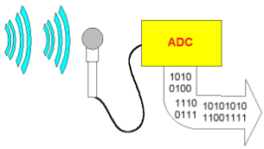
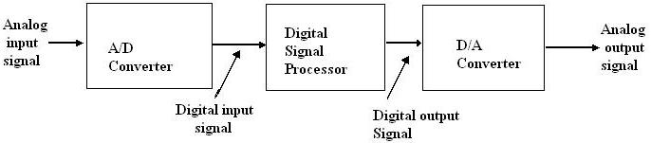
ELEMENTS OF A DIGITAL COMMUNICATION SYSTEM

Slide 8
PROCESS OF DIGITAL COMN
ANALOG SIG
DIGITAL SIG
SAMPLING
QUANTISATION
ENCODING

Slide 9
PULSE MODULATION
IT IS USED TO CONVERT ANALOG SIG INTO BINARY VALUES
ANALOG
DIGITAL
PTM
PULSE AMP MOD (PAM)
PCM
DELTA MOD
P WIDTH MOD (PWM)
(PPM)PULSE
POSN MOD

Slide 10
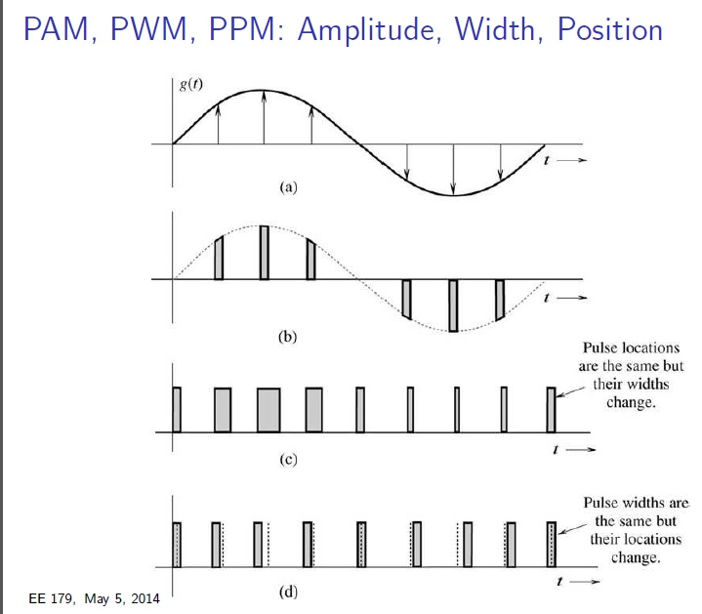
PULSE MODULATION

Slide 11
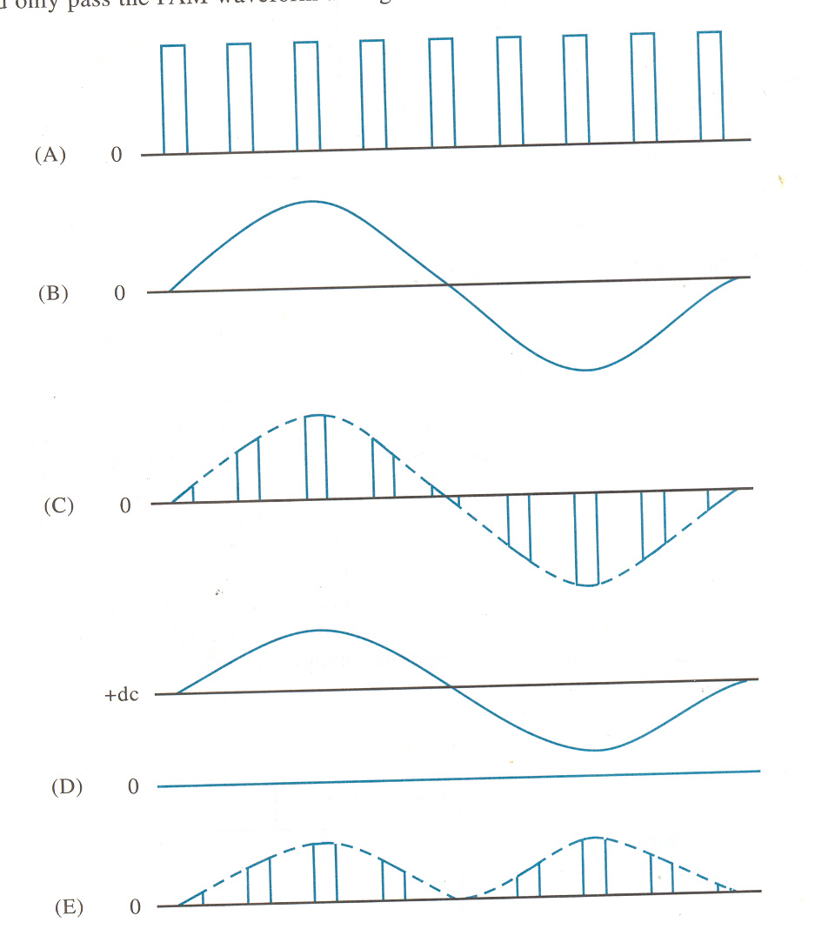
PULSE AMPLITUDE MODULATION

Slide 12
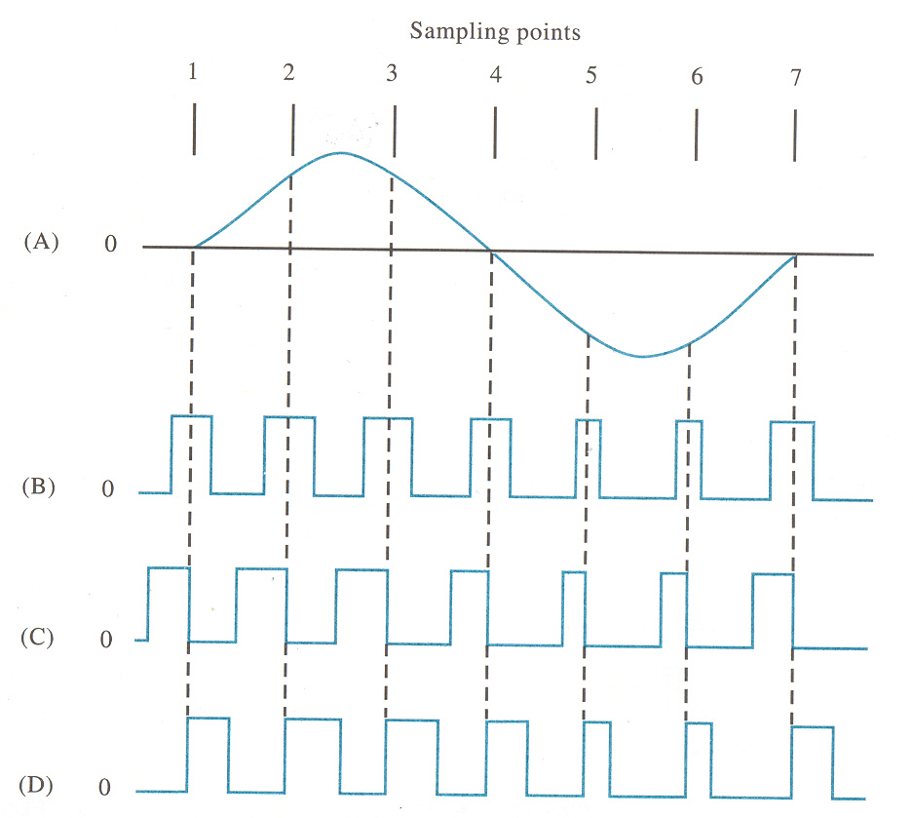
PULSE WIDTH MODULATION
MODULATING SIG
SYMMETRICAL PWM
LEADING EDGE PWM
TRAILING EDGE PWM

Slide 13
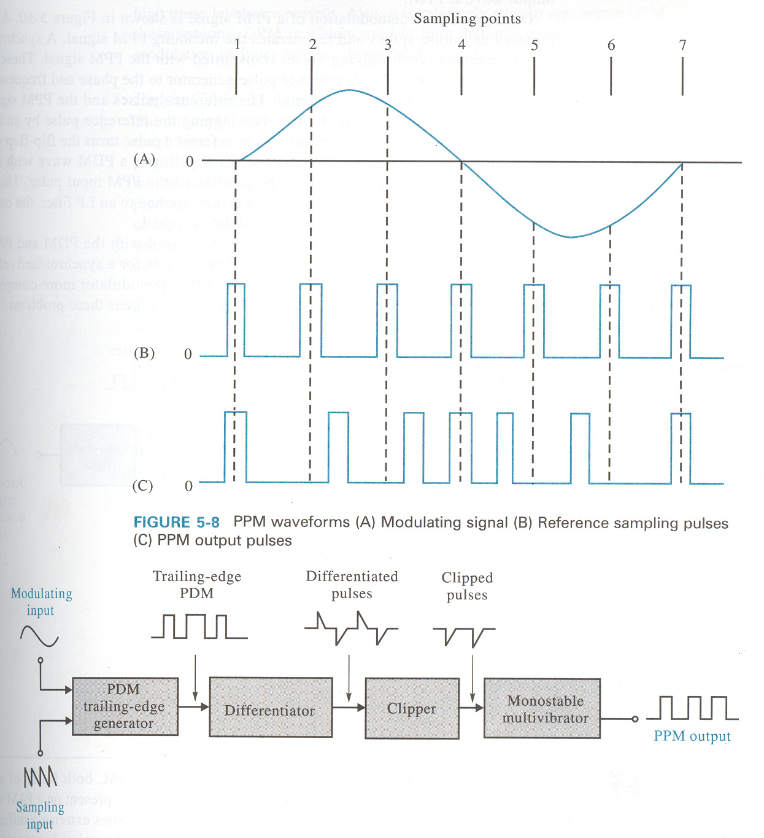
PULSE POSITION MODULATION

Slide 14
PULSE CODE MODULATION
SAMPLING :- THE PROCESS OF DIVIDING A SIG INTO TIME INTERVALS i.e THE SAMPLING RATE.
SAMPLING THEOREM :- IF THE SAMPLING RATE OF ANY PULSE MODE SYS EXCEEDS TWICE THE MAX OF THE SIG FREQ THE ORIG SIG CAN BE RECONSTRUCTED IN THE RECEIVER WITH MINIMUM DISTORTION.
fs 2 f(DATA SIG)
NOTE-USED FOR DETERMINING MIN SAMPLING RATE.

Slide 15
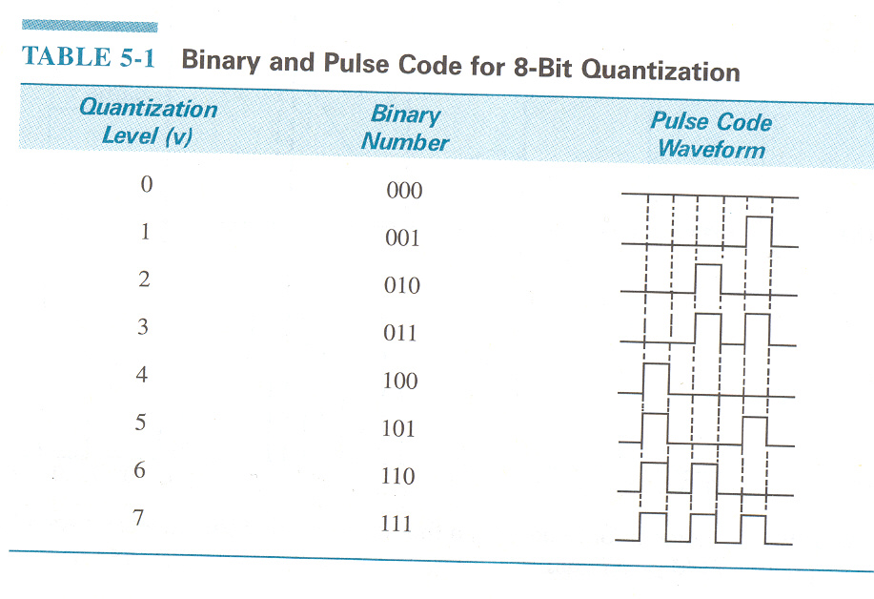
BINARY AND PULSE CODE

Slide 16
SAMPLING
In signal processing, sampling is the reduction of a continuous signal to a discrete signal. A common example is the conversion of a sound wave (a continuous signal) to a sequence of samples (a discrete-time signal). A sample is a value or set of values at a point in time and/or space.

Slide 17
QUANTIZATION
IT IS THE PROCESS OF ASSIGNING THE SAMPLE VALUE TO A NEAREST QUANTIFIABLE LEVEL . EACH OF THIS QUANTIFIABLE LEVELS IS ASSIGNED A FINITE NO OF CODES.

Slide 18
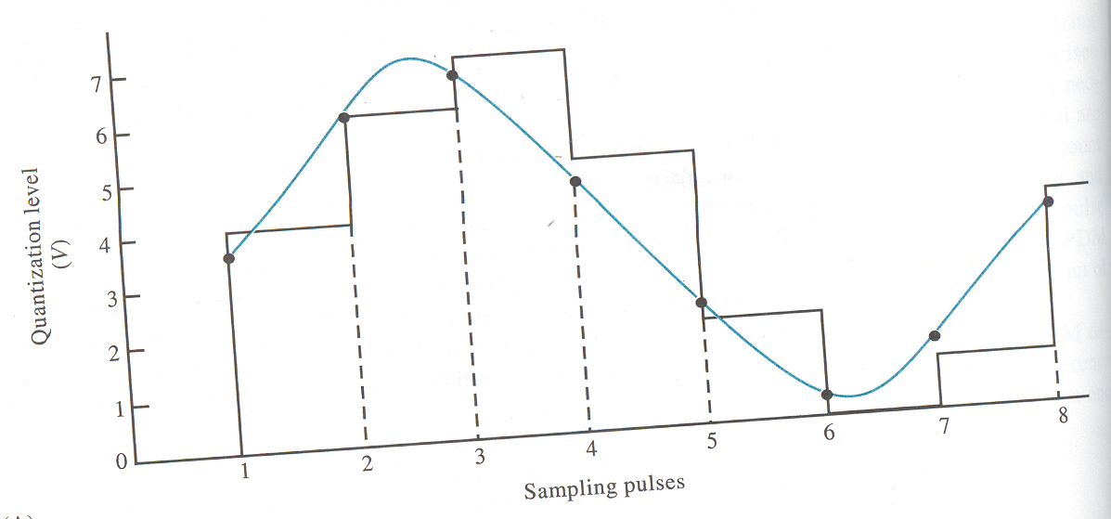
QUANTIZATION

Slide 19
ENCODING
THE PROCESS OF ASSIGNING CODE TO THE QUANTIFIABLE LEVEL OF THE INPUT SIGNAL. THUS THE SIGNAL IS CONVERTED INTO BINARY CODES.

Slide 20
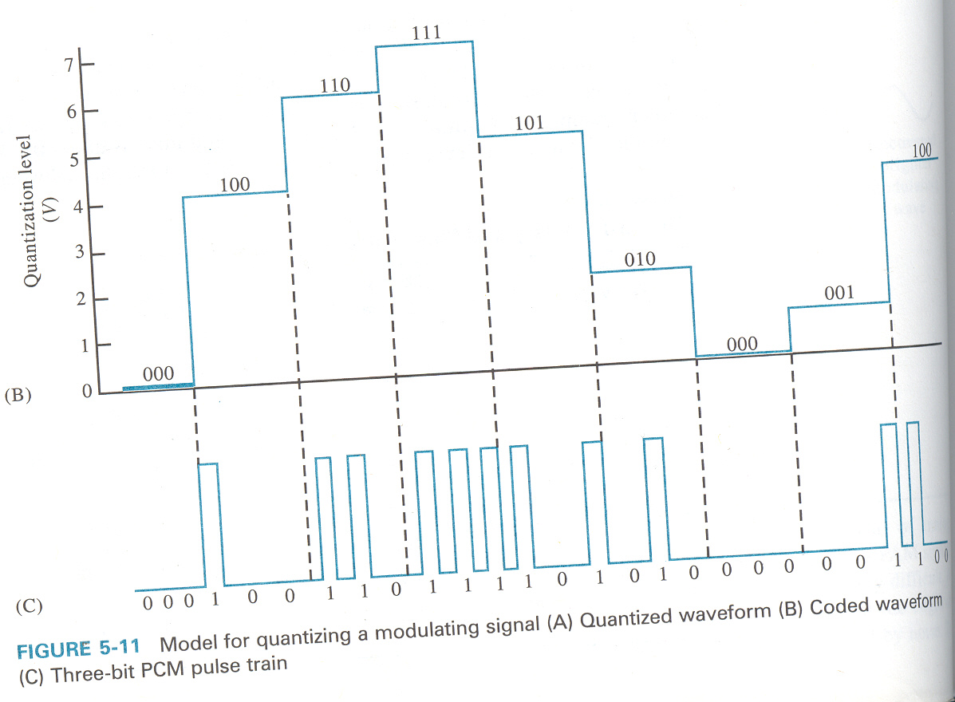
ENCODING

Slide 21
QUANTISATION NOISE
IF THE ACTUAL SIGNAL IS COMPARED TO QUANTISED SIGNAL, IT IS SEEN THAT QUANTISATION PROCESS INTRODUCES SOME DISTORTION ,THIS DISTORTION IS KNOWN AS QUANTISATION NOISE.

Slide 22
DELTA MODULATION
IT IS A PROCESS OF MODULATION WHERE A SERIES OF FIXED WIDTH PULSES IS TRANSMITTED , WHOSE POLARITY INDICATES WHETHER PRESENT INPUT SIG SAMPLE IS LARGER OR SMALLER THAN THE PREVIOUS SIGNAL SAMPLE.

Slide 23
DECIMAL TO BINARY
CONVERTING DECIMAL TO BINARY
1. DIVIDE THE DECIMAL NUMBER SUCCESSIVELY BY UNTIL THE QUOTIENT IS ZERO.
2. NOTE WHETHER EACH REMAINDER IS 0 OR 1.
3. THE REMAINDERS OF 0 AND 1 ARE DIGITS IN THE BINARY NUMBER.
13÷2 = 6 WITH REMAINDER OF 1
6 ÷2 = 3 WITH REMAINDER OF 0
3 ÷2 = 1 WITH REMAINDER OF 1
1 ÷2 = 0 WITH REMAINDER OF 1
13 = 1 1 0 1

Slide 24
BINARY TO DECIMAL
0
1
2
3
1101 = 1X2 + 0X2 + 1X2 + 1X2
= 1 + 0 + 4 + 8
= 13

Slide 25
ASCII CODES.
AMERICAN STD CODES FOR INFO INTERCHANGE.
BINARY TO DIGITAL .
DIGITAL TO BINARY .

Slide 26
ERROR DETECTION & CORRECTION
BY ADDING REDUNDANT BIT.
PARITY CHECK CODING.

Slide 27
PARITY CHECK CODING
TO ADD A SINGLE BINARY DIGIT TO EACH MSG FOR SPECIFIED LENGTH SO THAT OUTPUT OF THE DATA IS EVEN OR ODD . THE ADDED REDUNDANT BIT IS CALLED AS PARITY CHECK BIT .
IN THIS ONLY DETECTION OF ERRORS IS POSSIBLE.

Slide 28
BOOLEAN ALGEBRA AND LOGIC GATES
A.B =Y
A
Y
B
A B Y
0 0 0
0 1 0
1 0 0
1 1 1

Slide 29
AND GATE
BULB
S 1
S 2
V
(a) CCT
A
A.B =Y
B
(b) LOGIC SYMBOL

Slide 30
OR GATE
S1
BULB
S2
V
(A)
A
A+B =Y
B
( B)

Slide 31
OR GATE
INPUT
OUT PUT
A
B
Y
0
0
0
0
1
1
1
0
1
1
1
1

Slide 32
NOT GATE
A
Y
A Y
Y=A 0 1
1 0

Slide 33
NOR GATE
A
Y
B
A B Y
0 0 1
0 1 0
1 0 0
1 1 0
Y=A+B

Slide 34
NOR GATE
A
B
A+B = Y
INPUTS
OUT PUT
B
Y
A
0
1
0
0
1
0
1
0
0
1
1
0

Slide 35
X-OR GATE
A
B
Y
A B Y
0 0 0
0 1 1
1 0 1
1 1 0
Y=A + B

Slide 36
EX NOR ( X NOR)
A
+
B = Y
INPUTS
OUT PUT
B
Y
A
0
1
0
0
1
0
Odd
Odd
1
0
0
Even
1
1
1

Slide 37
SYMBOL
INPUT
OUTPUT
GATE
ALL 1
ANY 0
1
0
AND
IN
OUT
NOT
IN
OUT
1
0
0
1
NAND
ALL 1
ANY 0
0
1
IN
OUT
OR
ALL 0
ANY 1
0
1
IN
OUT
ALL 0
ANY 1
1
0
NOR
IN
OUT
XOR
EVEN IS
ODD IS
0
1
IN
OUT
XNOR
ODD IS
EVEN IS
0
1
IN
OUT

